Slide 1
Sport Hub to buy sport tickets for different sport events in different cities for different games and leagues
Team - 3
Project Statement
By:-
Miraj Vekaria (A20504946)
Hemanth Thathireddy (A20525346)

Slide 2
Project Overview
The Sports Hub project aims to develop a web-based platform that allows users to purchase tickets for various sporting events in various cities, for various games and leagues, and also allows event organizers to register their events on the platform. The platform will have an easy-to-use interface that allows users to search for and filter events based on location, date, team, and league. Users will be able to view available seats, choose and purchase tickets, and receive email confirmation and e-tickets. To ensure seamless transactions and secure payment processing, different payment gateways will be integrated. The Sports Hub will use web technologies to provide users with a fast and responsive experience, allowing them to quickly find and purchase tickets for their favorite sporting events.

Slide 3
Design patterns being utilized..
Observer pattern:-
This pattern allows an object to notify other objects when its state changes. In the context of an online ticket buying system, the observer pattern could be used to notify users when any new event registered or existing event gets updated or new tickets become available or when the status of their purchased tickets changes.
2. Factory Method pattern:-
This pattern provides an interface for creating objects, but allows subclasses to alter the type of objects that will be created. In the context of an online ticket buying system, the factory pattern could be used to create different types of tickets or tickets with different features.
3. Strategy Pattern :-
This pattern defines a family of algorithms and encapsulates each one, making them interchangeable. In the context of an online ticket buying system, the strategy pattern could be used to allow users to choose different payment methods for purchasing tickets.

Slide 4
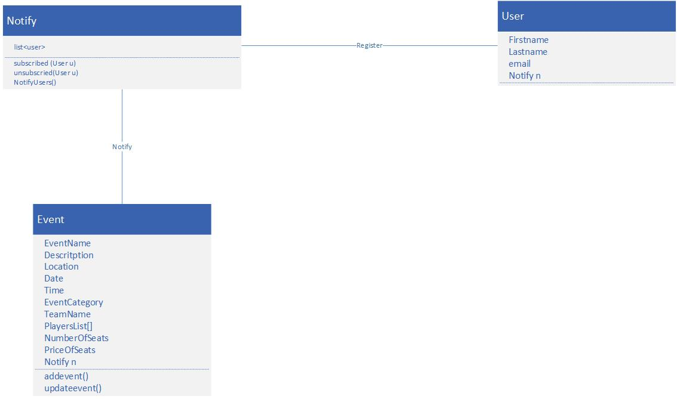
Observer Pattern

Slide 5
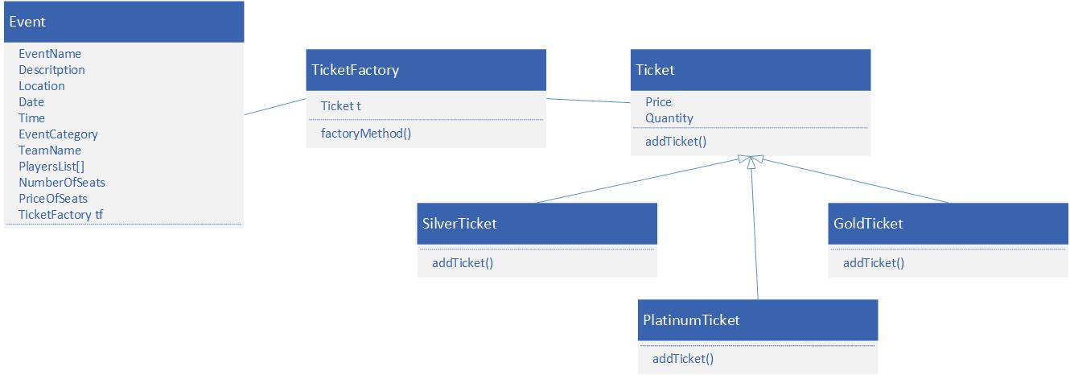
Factory Method Pattern

Slide 6
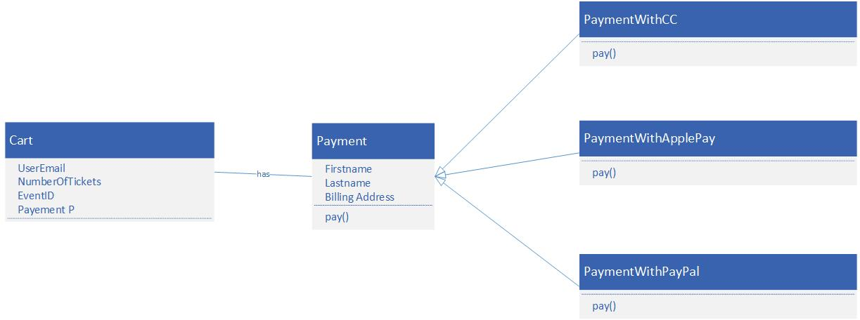
Strategy Pattern

Slide 7
Feel Free to Ask Any Questions If you have!
Thank You!!

